Slide 1
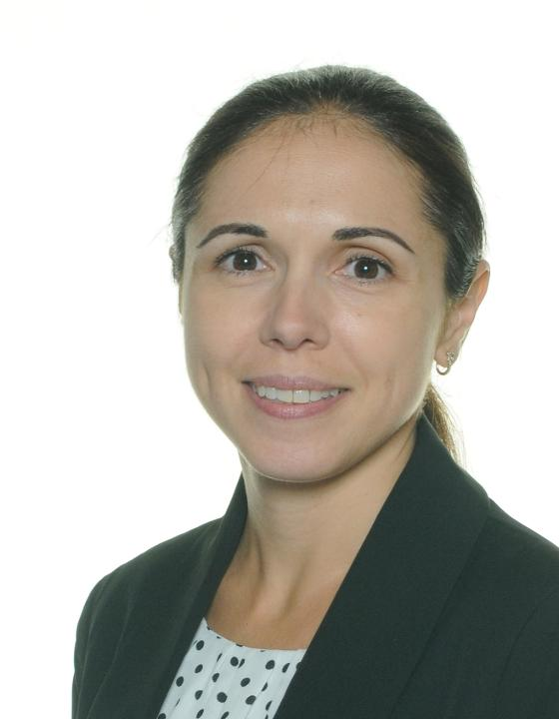
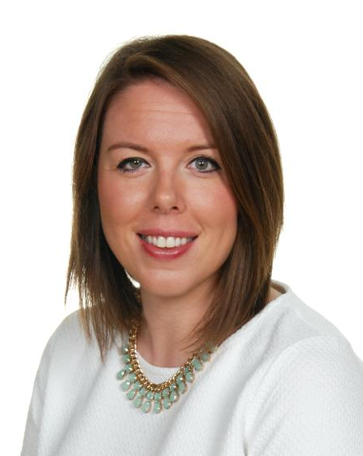
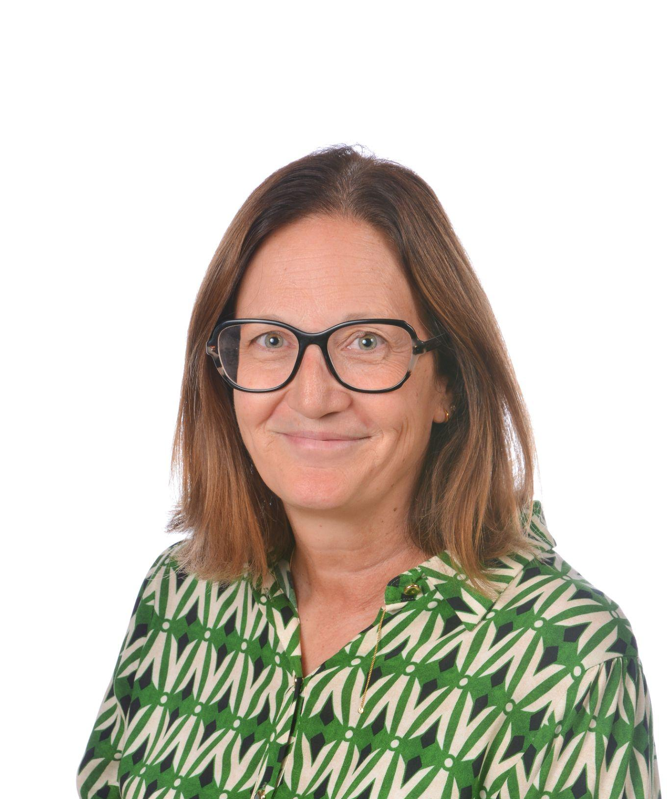
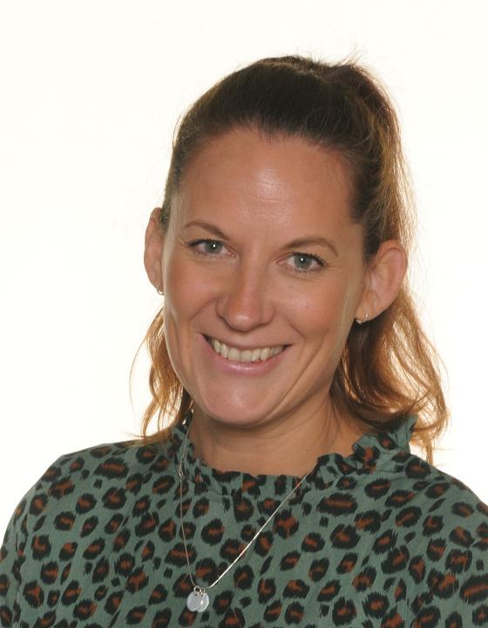
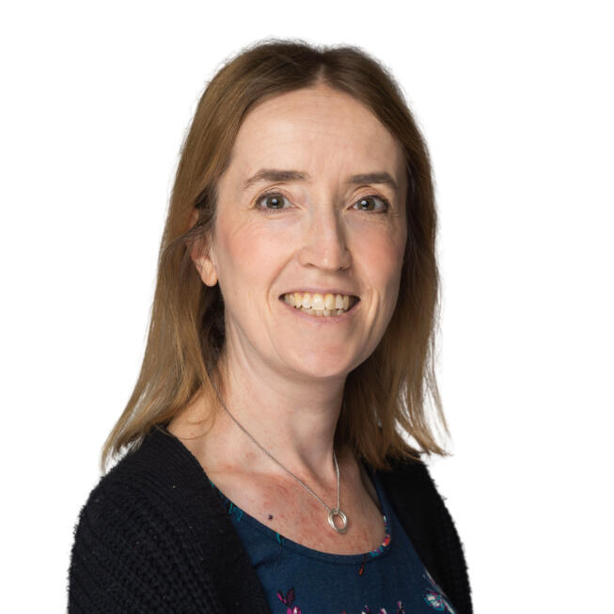

Hayes Primary School is committed to the safety and the well being of our children and staff
Creating a Safe and Inclusive Environment
If you have any concerns, please contact the designated people with responsibility for safeguarding and child protection in this school. You can contact the team by calling 0208 462 1769 or by emailing dsl@hayes-pri. bromley.sch.uk
Safeguarding
Mrs Howell
Designated
Safeguarding Lead
Miss Hughes
Deputy
Safeguarding Officer
Mrs Field
Deputy
Safeguarding Officer
Mrs Griffin
Deputy
Safeguarding Officer
Mrs Larkman
Deputy
Safeguarding Officer
Hannah Dalton
Safeguarding Trustee
hdalton@springptrust.uk
Children and Families Hub:
Bromley - 0208 461 7373/7309 (Out of Hours - 0300 303 8671)
Croydon - 0208 255 2888 (Out of Hours - 0208 726 6400)
Lewisham - 0208 314 6660 (Out of Hours - 020 8314 6000)
LADO - 0208 461 7775
Prevent Police - prevent@bromley.gov.uk

Slide 2



Everyone who comes into contact with children and their families has a role to play in safeguarding children
What is Safeguarding?
protecting children from maltreatment
preventing impairment of children’s health or development
ensuring that children are growing up in circumstances consistent with the provision of safe and effective care; and
taking action to enable all children to have the best outcomes
What is Child Protection?
Child protection is part of safeguarding
It is activity undertaken to protect specific children who are suffering or at risk of suffering significant harm
Where a child is suffering significant harm, or is likely to do so, action should be taken to protect that child
Action should also be taken to promote the welfare of a child in need of additional support, even if they are not suffering harm or are at immediate risk
Dos and Don’ts when working at Hayes Primary School
Do make sure you sign in at reception
Do make sure we have seen your DBS
Don’t use your mobile phone on school premises
Don’t give a child your personal details
Do only use school equipment for photographs and videos
Do read the Safeguarding guidance notes
Safeguarding

